Slide 1
Common Coupling at File-Level and Method-Level Granularity
Final Presentation
Kevin Nguyen, Jacqueline Wong - Team 4

Slide 2
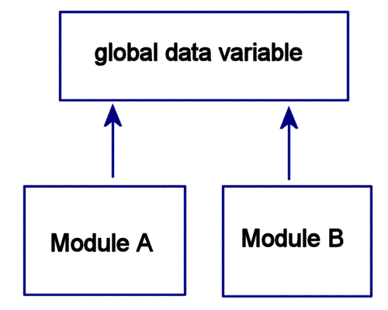
Background Information
Common Coupling
“Common coupling (also known as Global coupling) occurs when two modules share the same global data (e.g., a global variable).” [1]
[1] Wikipedia. https://en.wikipedia.org/wiki/Coupling_(computer_programming)

Slide 3
Technologies Used
Java and Eclipse ASTVisitor
Used to write the common coupling detection tool
Similar to Assignment 4 (GeneralVisitor and MainVisitor)
Various Java Systems
The common coupling detection tool will be run on these Java systems.
Ex. Freemind, CMS Java

Slide 4
Additions since Intermediary Report
Implemented monitoring of protected static variables
Keep track of what subclasses are using a superclasses’ protected static variables
Not necessarily a global variable, but we considered it an edge case of common coupling
Gold set construction
Automatic git grep for file-level
Manual gold set creation on some files for method-level
Examining variable declarations in addition to method bodies when detecting coupling

Slide 5
Common Coupling: File-Level Granularity
Create a list of non-private static variables (“Global” variables)
For each file, create a list of Method Bodies and Variable Declarations
Check if any of the non-private static variables in the list occur in the method bodies and variable declarations.
If there is an occurrence, add the file name the occurrence happened in into a list if:
The file name is not already in that list.
Print all “global” variables that have 2+ occurrences and the files they were used in.

Slide 6
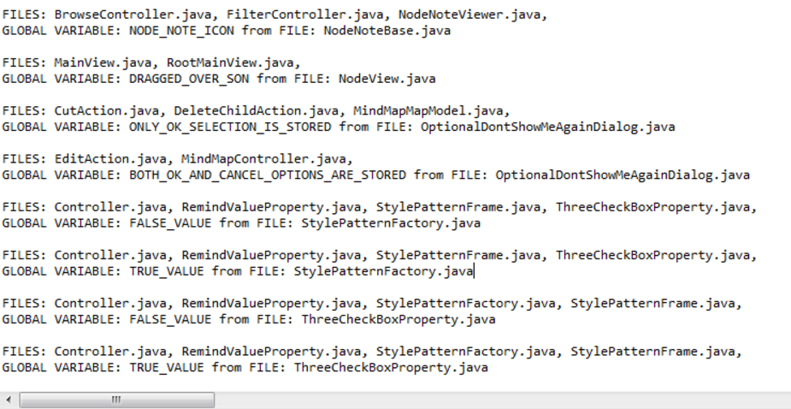
FreeMind Results
-FreeMind Output (File-Level Granularity)

Slide 7
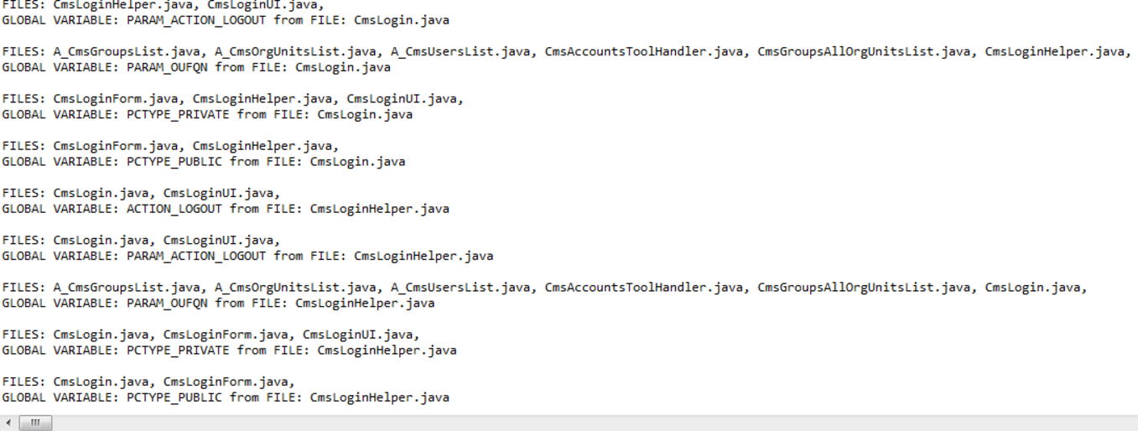
CMS Results
-CMS Output (File-Level Granularity)

Slide 8
Common Coupling: Method-Level Granularity
Create a list of instance variables.
For each file, create a list of Method Bodies and Names
Check if any of the instance variables in the list occur in the method bodies.
If there is an occurrence, add the method name the occurrence happened in into a list if:
The method name is not already in that list.
Print all instance variables that have 2+ occurrences and the methods they were used in.

Slide 9
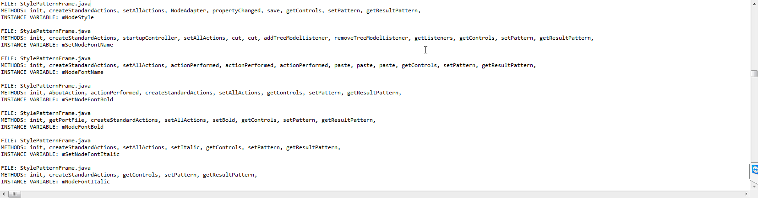
FreeMind Results
-FreeMind Output (Method-Level Granularity)

Slide 10
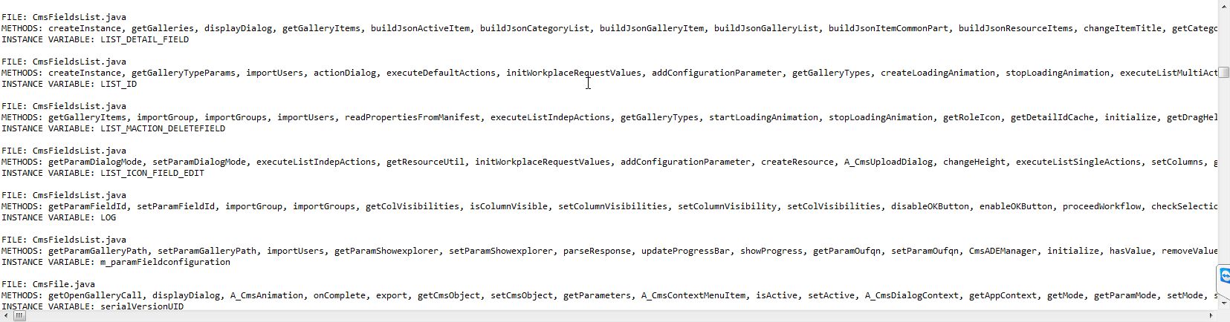
CMS Results
-CMS Output (Method-Level Granularity)
Notes:
If asked, here are samples of full line result: http://i.imgur.com/SpED4lb.png

Slide 11
Evaluation of Common Coupling Tool
How accurate is this ASTVisitor Common Coupling Tool at file-level granularity?
How accurate is this ASTVisitor Common Coupling Tool at method-level granularity?

Slide 12
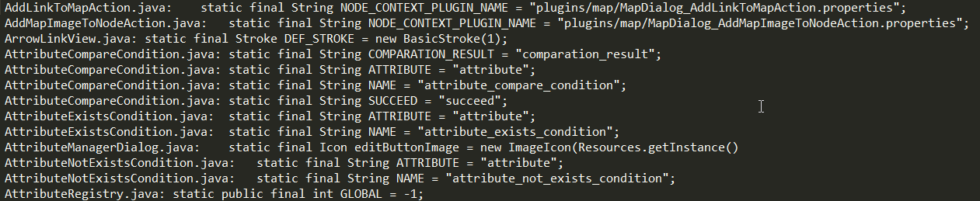
Gold Set Creation: File-Level Granularity
Used grep to write lines which had non-private, static variables to a file.
Chained grep commands to filter out non-variable items (Ex. public static methodName())

Slide 13
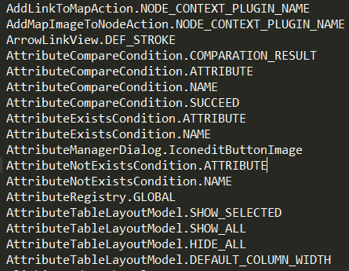
Gold Set Creation: File-Level Granularity
Parsed the file to make fileName.variableName and wrote that to a second output file. For example:
A_CmsAjaxGallery.java: public static final String DIALOG_LIST = "list";
=> A_CmsAjaxGallery.DIALOG_LIST

Slide 14
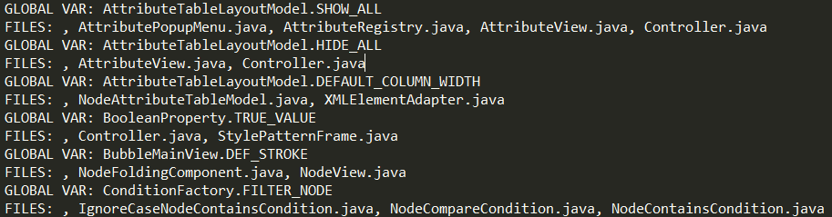
Gold Set Creation: File-Level Granularity
Ran the second output file against the system to check if there were 2+ occurrences. Global variables with 2+ occurrences were written to a final output file (Gold Set).

Slide 15
File-Level Granularity Comparison
Only FreeMind gold set was created successfully.
The common coupling tool identified all global variables found in the gold set.
Didn’t compare all results, but most files that used the global variables were also correct identified by the tool compared to the gold set.
 | Precision | Recall | F Measure
Freemind Java (Global Variables) | 1 | 1 | 1
Freemind Java (Common Coupled Methods) | 1 | 1 | 1

Slide 16
Gold Set Creation: Method-Level Granularity
Gold sets were constructed for both OpenCMS and Freemind Java.
Manually examined instance variables in source files
Kept track of where these variables were used in the class methods.
Performed for two files in each open source system.
OpenCMS: CmsPublicationNotification.java and CmsExtendedNotificationCause.java
Freemind: FreemindSplashModern.java and LogFileLogHandler.java

Slide 17
Method-Level Granularity Comparison
Precision, Recall, and F Measure
In all of these files, it was found that our Common Coupling detection program found all of the instances of method-level coupling in the gold set
No instances of false-positives, thus producing a precision, recall, and F Measure of 1 for method-level granularity
 | Precision | Recall | F Measure
OpenCMS | 1 | 1 | 1
Freemind Java | 1 | 1 | 1

Slide 18
Current Issues
Not enough results to compare.
Assumptions made in the program
Good naming convention (i.e. if a parameter variable has the same name as an instance variable, then they are related)
Could address problem by monitoring use of this Java keyword to ensure relation
Gold Set Creation not perfect
Assumptions made in creating the gold set.
Manual editing prone to error.
Issues creating gold sets for some systems.
System Size?
Will be debugged and remedied before the final report.

Slide 19
Attempted Additions
Concept: Other external data identification
Database
Find files that create DB connections to the same database
Check if files also use same tables when running queries
Distinguish between SELECT queries and UPDATE queries
Files
Keep track of File declarations and what they use to initialize said Files
Monitor which Java source files use the same file based on matching initializers when creating Java File objects in source code
Distinguish between File reading and File writing

Slide 20
Conclusion
Our Common Coupling Detection program is able to detect method-level coupling effectively based on initial gold set measurements
Testing on file-level granularity pending full completion, but manual looks at files based on results look promising
Other Future Considerations
Using srcML instead of Eclipse ASTVisitor
The more lightweight approach, useful for larger systems
Greater flexibility

Slide 21
Questions?

